Slide 1
Object Oriented Design System Modeling
Part- 2

Slide 2
Topics covered
Context models
Interaction models
Structural models
Behavioral models

Slide 3
Interaction models
Modeling user interaction is important as it helps to identify user requirements.
Modeling system-to-system interaction highlights the communication problems that may arise.
Modeling component interaction helps us understand if a proposed system structure is likely to deliver the required system performance and dependability.
Use case diagrams and sequence diagrams may be used for interaction modeling.

Slide 4
Use case modeling
Use cases were developed originally to support requirements elicitation and now incorporated into the UML.
Each use case represents a discrete task that involves external interaction with a system.
Actors in a use case may be people or other systems.
Represented diagramatically to provide an overview of the use case and in a more detailed textual form.

Slide 5

Transfer-data use case
A use case in the MHC-PMS

Slide 6
Tabular description of the ‘Transfer data’ use-case
MHC-PMS: Transfer data
Actors | Medical receptionist, patient records system (PRS)
Description | A receptionist may transfer data from the MHC-PMS to a general patient record database that is maintained by a health authority. The information transferred may either be updated personal information (address, phone number, etc.) or a summary of the patient’s diagnosis and treatment.
Data | Patient’s personal information, treatment summary
Stimulus | User command issued by medical receptionist
Response | Confirmation that PRS has been updated
Comments | The receptionist must have appropriate security permissions to access the patient information and the PRS.

Slide 7
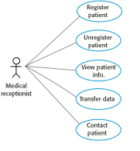
Use cases in the MHC-PMS involving the role ‘Medical Receptionist’

Slide 8
Sequence diagrams
Sequence diagrams are part of the UML and are used to model the interactions between the actors and the objects within a system.
A sequence diagram shows the sequence of interactions that take place during a particular use case or use case instance.
The objects and actors involved are listed along the top of the diagram, with a dotted line drawn vertically from these.
Interactions between objects are indicated by annotated arrows.

Slide 9
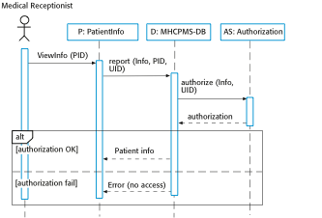
Sequence diagram for View patient information

Slide 10
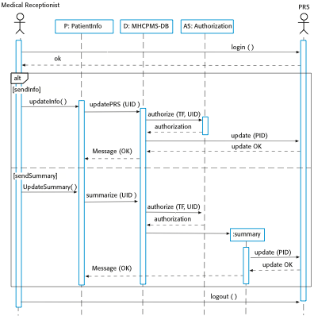
Sequence diagram for Transfer Data

Slide 11
Thank You!

